Slide 1
Bank Personal Loan Modelling
Delivered by:
Waad alduhami

Slide 2
Outline
EDA
Dateset
Preprocessing
INTRODUCTION
Modeling

Slide 3


INTRODUCTION
THE TARGET IN THE PROJECT IS (PERSONAL LOAN )
PRESONAL LOAN: A personal loan (also known as a consumer loan) describes any situation in which an individual borrows money for personal need, including making investments in a company.

Slide 4
Dataset Description:
Description | Feature
Customer id | ID
Customer's age in completed years | Age
Annual income of the customer | income
Avg spending on credit cards per month | CCAvg
Did this customer accept the personal loan offered in the last campaign? | Personal Loan
years of professional experience | Experience
Education Level. 1: Undergrad; 2: Graduate; 3: Advanced/Professional | Education
The file Bank contains data on 5000 customers. The data include customer demographic information (age, income, etc.), the customer's relationship with the bank (mortgage, securities account, etc.), and the customer response to the last personal loan campaign (Personal Loan)

Slide 5
Preprocessing
Check if there any missing values.
Check if there and duplicate.
Remove Outliers.
Create Dummy variables.

Slide 6
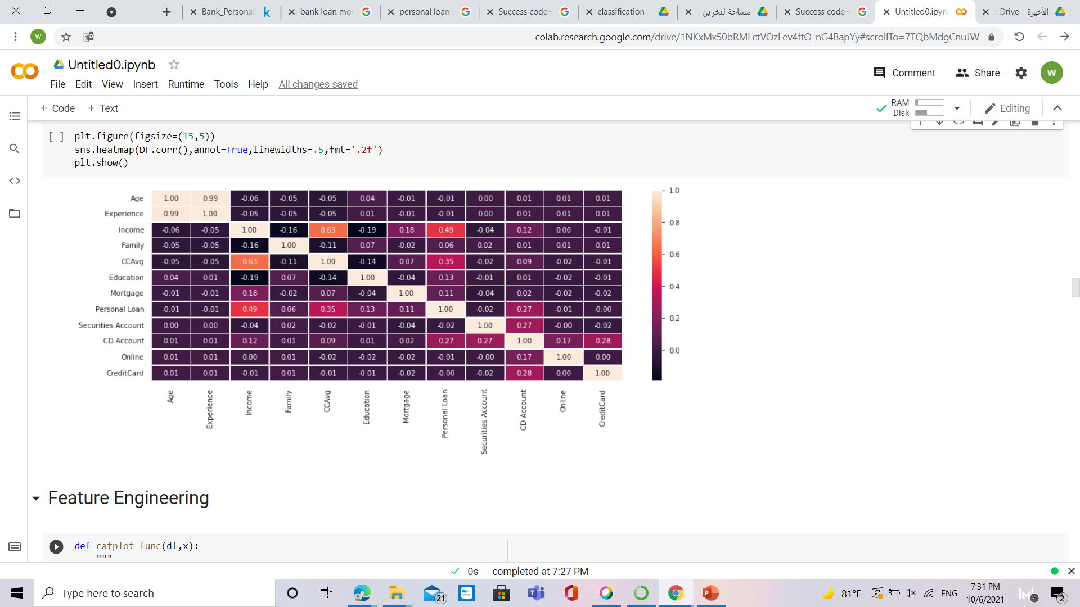
EDA:

Slide 7
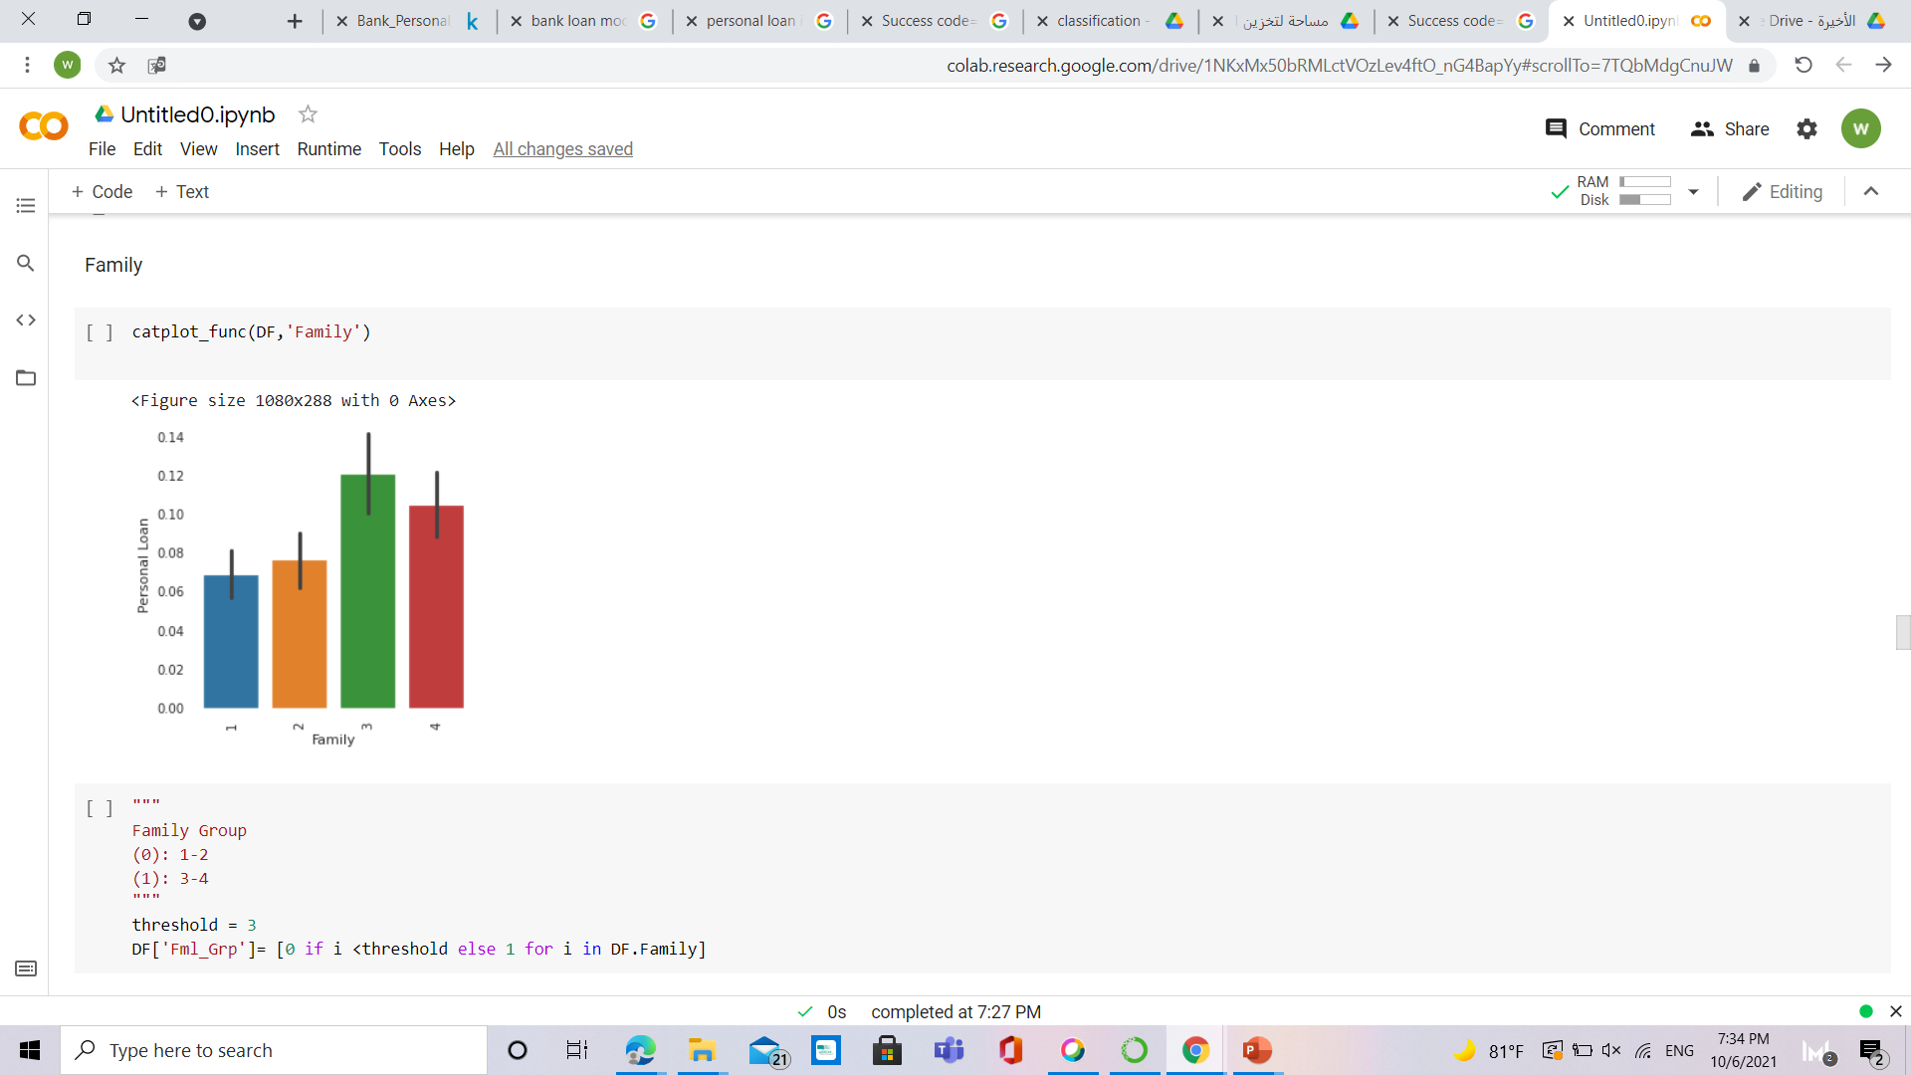
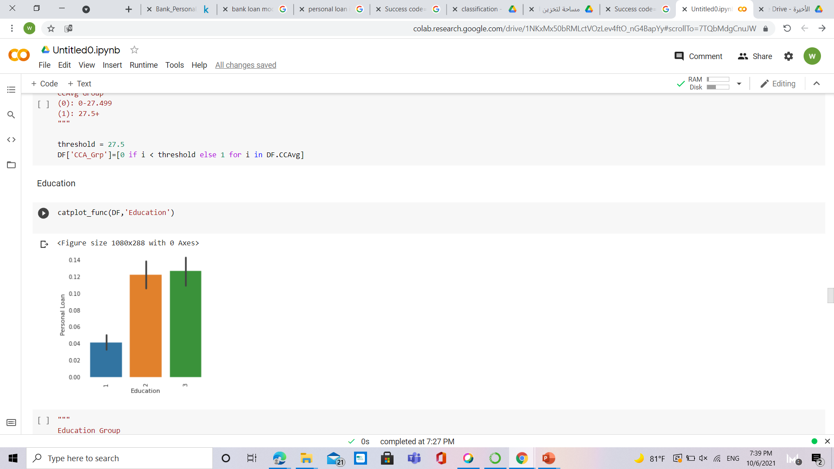
EDA:

Slide 8
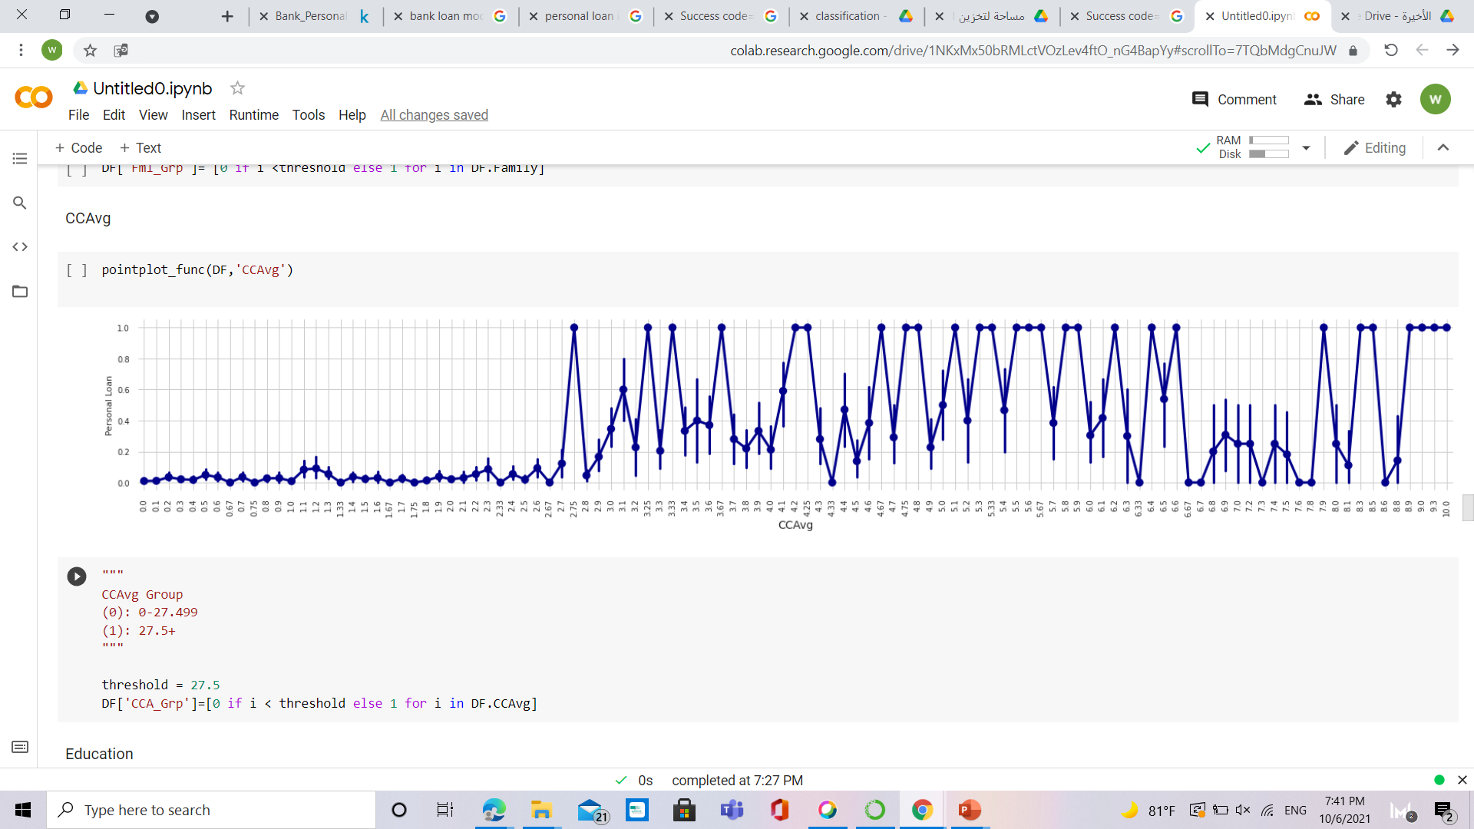
EDA:

Slide 9
Modeling

Slide 10
Modeling:
CV SCORE:
Random
Forest
0.9974
Gradient Boosting
0.9976
KNN
0.95
Logistic
Regression
Naive
Bayes
0.96
0.93

Slide 11
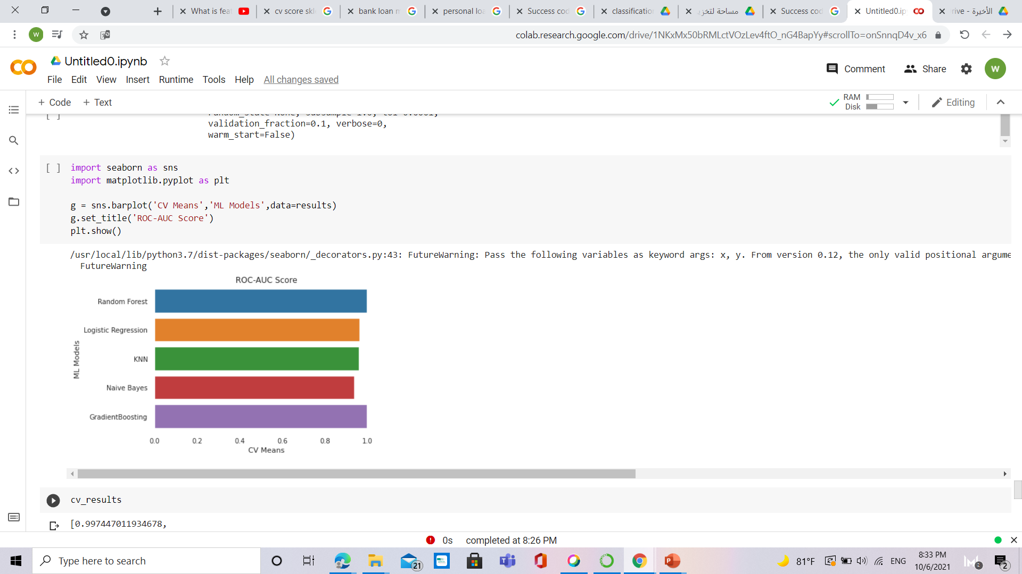

Slide 12
THANKS

